Slide 1

Enhancing Fraud Detection with ML
Sahil Kumar
Arka Jain University
Student CS & IT

Slide 2


Agenda
Problem Statement Primary goals​
Proposed System/Solution
System Development Approach Algorithm & Deployment
​Result
Conclusion
References

Slide 3

Problem Statement
In today's financial landscape, the proliferation of fraudulent activities poses significant challenges to financial institutions, impacting their bottom line and eroding trust among stakeholders. To mitigate these risks, innovative approaches leveraging technology have become imperative. This overview delves into the integration of basic analysis techniques, machine learning algorithms, and visualization techniques to detect and prevent financial fraud.

Slide 4

Proposed Solution
The proposed system aims to address the challenge of predicting the fraudulent chances based on various attributes to prevent customers from fraud. This involves leveraging data analytics and machine learning techniques to forecast fraud’s patterns accurately based on various aspects.
2024
ENHANCING FRAUD DETECTION WITH ML
4

Slide 5

System Approach
The "System Approach" section outlines the overall strategy and methodology for developing and implementing the fraud prediction system. Here's a suggested structure for this section:
System Requirements: Windows 11, 8 GB RAM, 512 GB storage, AMD Ryzen 7 5825U with Radeon Graphics 2.00 GHz
Required Libraries: NumPy, pandas, scikit-learn, Matplotlib, Seaborn.

Slide 6
Algorithm & Deployment
Algorithm Selection
Data Input​
Three distinct machine learning models are employed in our analysis: linear regression, logistic regression and Random forest classifier.
Linear regression is utilized to predict the likelihood of fraud based on transactional attributes such as 'amount' and 'customer_age'. Meanwhile, logistic regression is leveraged to assess the probability of fraud occurrence concerning customer age specifically, providing a targeted approach to identifying suspicious transactions. Additionally, the Random Forest classifier is employed to enhance fraud detection accuracy by leveraging its ensemble learning capabilities, analyzing multiple decision trees to improve prediction performance and robustness.
Prediction Process:
Based on attributes like 'amount', 'card_type_n', 'purchase_category_n', 'customer_age’, etc. are used to predict ‘is_fraudulent’ attribute. Also, some attributes are used after transforming it through ‘label_encoder’ and ‘standard_scaler’.

Slide 7
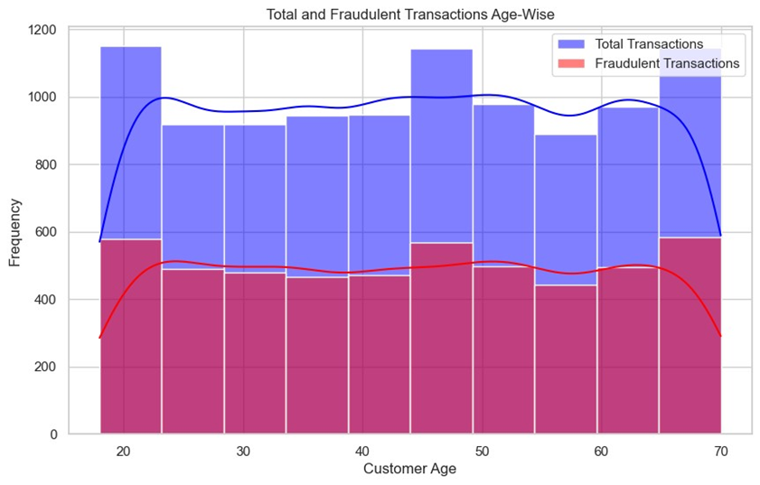
Result
Analysis 1
Examining transaction data age-wise unveils distinct patterns, highlighting potential age groups more susceptible to fraudulent activities, crucial for tailoring fraud prevention strategies effectively.

Slide 8
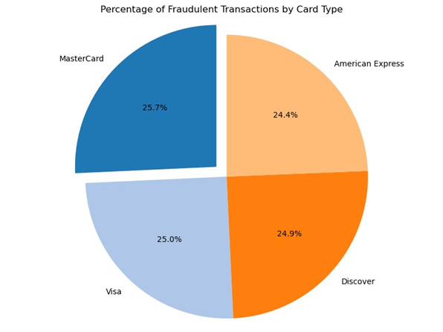
Result
Analysis 2
Analyzing the percentage of fraudulent transactions by card type provides insights into whether certain types of cards are more susceptible to fraudulent activity, informing issuers and insurers for targeted fraud prevention measures.

Slide 9
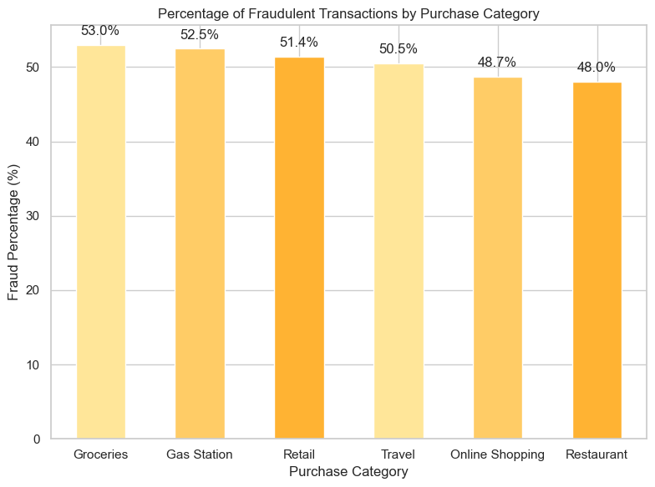
Result
Analysis 3
Calculating the percentage of fraudulent transactions per purchase category offers valuable insights into the prevalence of fraud across different types of purchases, guiding insurers in prioritizing fraud detection efforts and implementing preventive measures in high-risk categories.

Slide 10
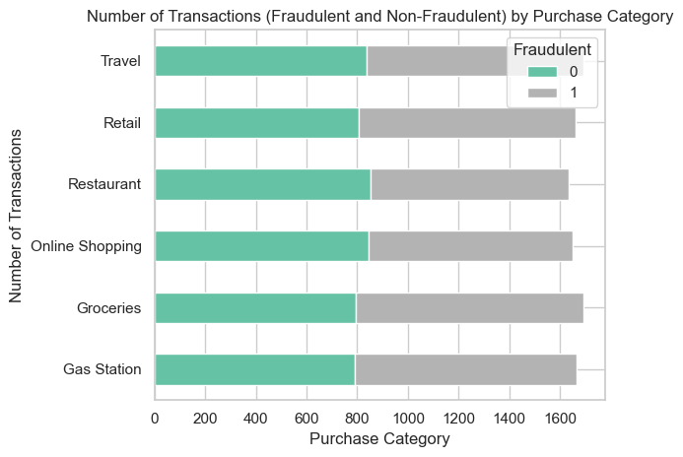
Result
Analysis 4
Assessing the number of transactions categorized as fraudulent and non-fraudulent across different purchase categories unveils the distribution of fraud incidents, aiding in understanding fraud trends and allocating resources for targeted fraud prevention strategies.

Slide 11
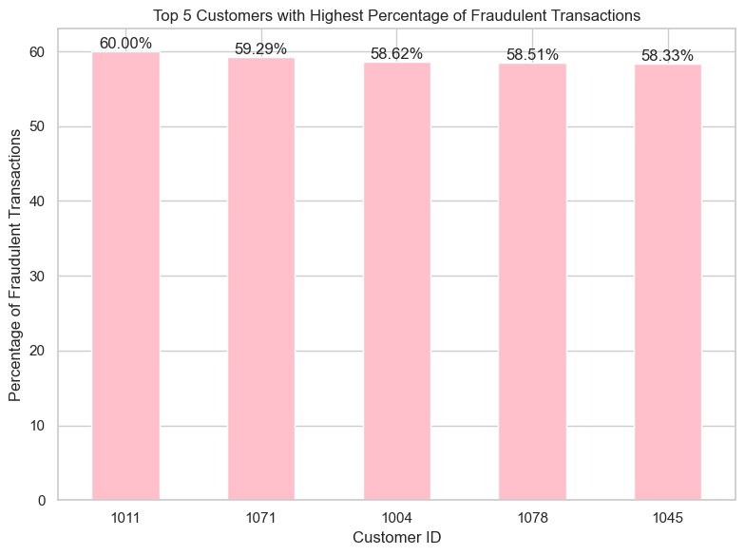
Result
Analysis 5
Identifying the top 5 customers with the highest percentage of fraudulent transactions allows for targeted intervention and monitoring of accounts exhibiting suspicious behavior, mitigating potential losses and strengthening fraud prevention measures for individual customers.

Slide 12
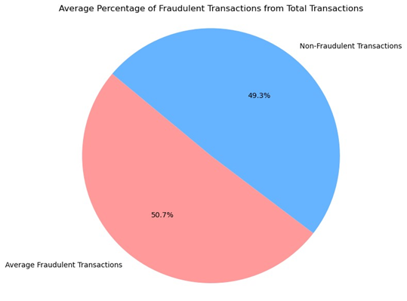
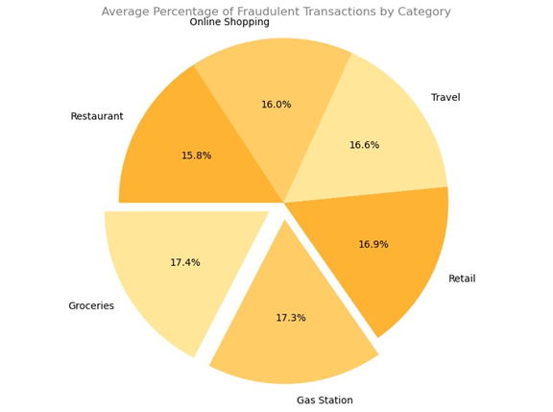
Result
Analysis 6
Determining the average percentage of fraudulent transactions by category provides a comprehensive overview of fraud prevalence across various transaction types, aiding insurers in identifying areas of vulnerability and implementing proactive measures to combat fraudulent activities effectively.

Slide 13
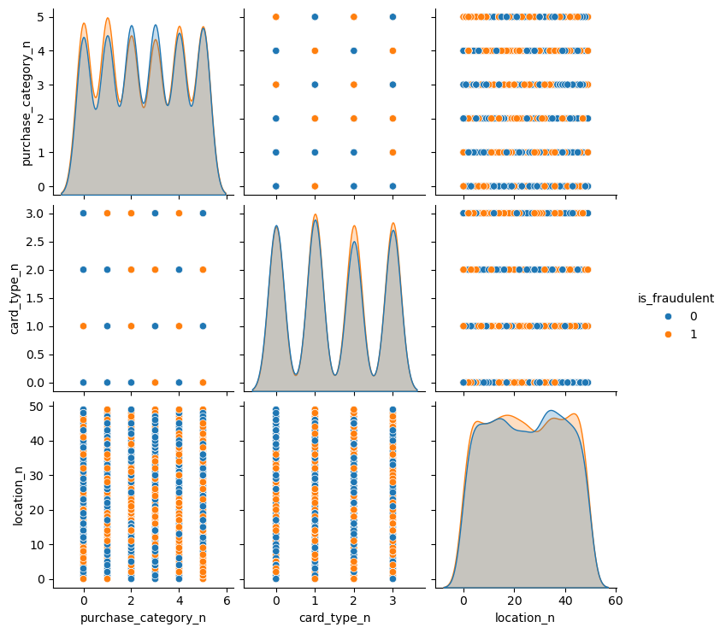
RESULT
A pair plot visually analyzes relationships between variables like card type, purchase category, and location concerning fraudulence. It maps correlations, distributions, and outliers, revealing patterns where specific card types, purchase categories, or locations consistently appear in fraudulent transactions, aiding in fraud detection and prevention strategies.

Slide 14
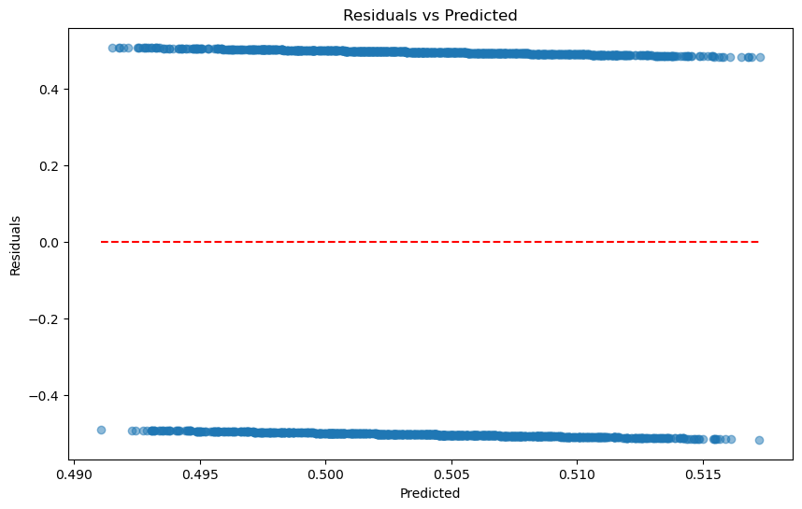
RESULT
The residual plot displays the difference between actual and predicted values (residuals) against predicted values. It helps assess if the model's errors are randomly distributed around zero (ideal) or exhibit a pattern (indicating bias or inconsistency). A horizontal red dashed line at zero indicates balanced predictions; deviations imply model inadequacies.

Slide 15
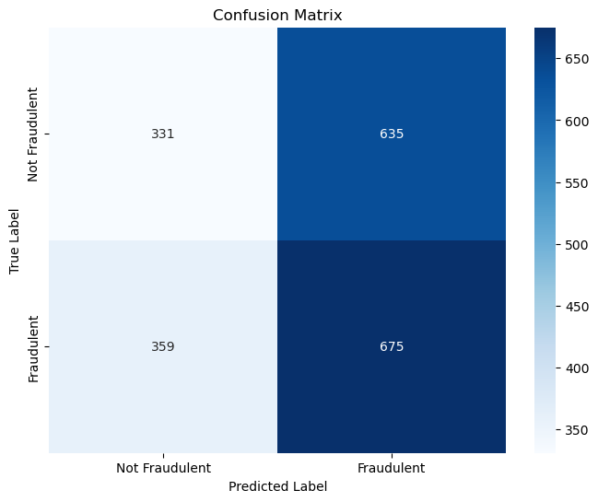
RESULT
The confusion matrix heatmap visually summarizes a binary classification model's performance, such as logistic regression for fraud detection. It displays counts of correctly and incorrectly predicted outcomes ('Not Fraudulent' and 'Fraudulent'). The diagonal from top-left to bottom-right indicates accurate predictions, while off-diagonal elements signify errors in classification.

Slide 16
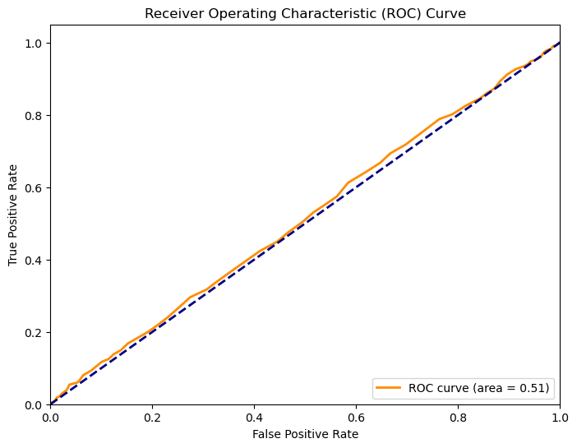
RESULT
The ROC curve plots the true positive rate (sensitivity) against the false positive rate (1-specificity) for varying classification thresholds of a binary classifier, here likely a logistic regression model for fraud detection. The area under the ROC curve (AUC) quantifies model performance; a higher AUC indicates better discrimination ability between fraud and non-fraud cases.

Slide 17
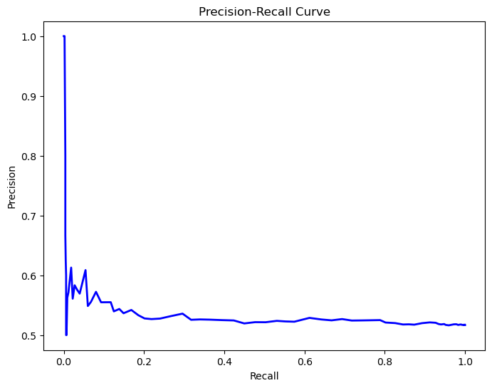
RESULT
The Precision-Recall curve depicts the trade-off between precision (positive predictive value) and recall (sensitivity) for varying thresholds of a binary classifier, often used in scenarios like fraud detection. It illustrates how well the model identifies positive cases (fraud) while maintaining precision, crucial for evaluating performance when classes are imbalanced.

Slide 18


Conclusion
In conclusion, the integration of data analysis and machine learning represents a pivotal advancement in the ongoing battle against insurance fraud. Through meticulous examination of transactional data and the application of sophisticated algorithms, insurers can stay one step ahead of fraudsters, ensuring the integrity and sustainability of the insurance industry for years to come.

Slide 19
References
Kaggle
Anaconda navigator
google
GitHub
Edunet foundation
For dataset.
For jupyter notebook.
For research work.
For technology and methods better understanding.

Slide 20
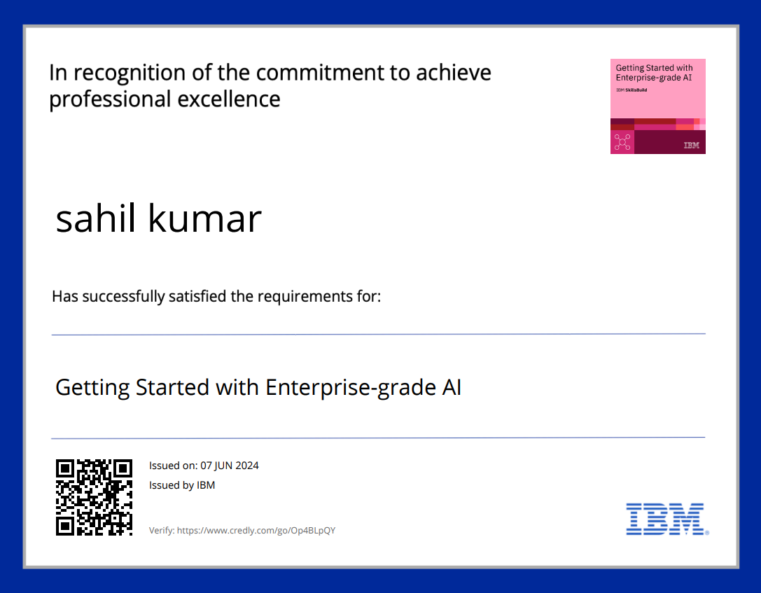

COURSE CERTIFICATE 1

Slide 21
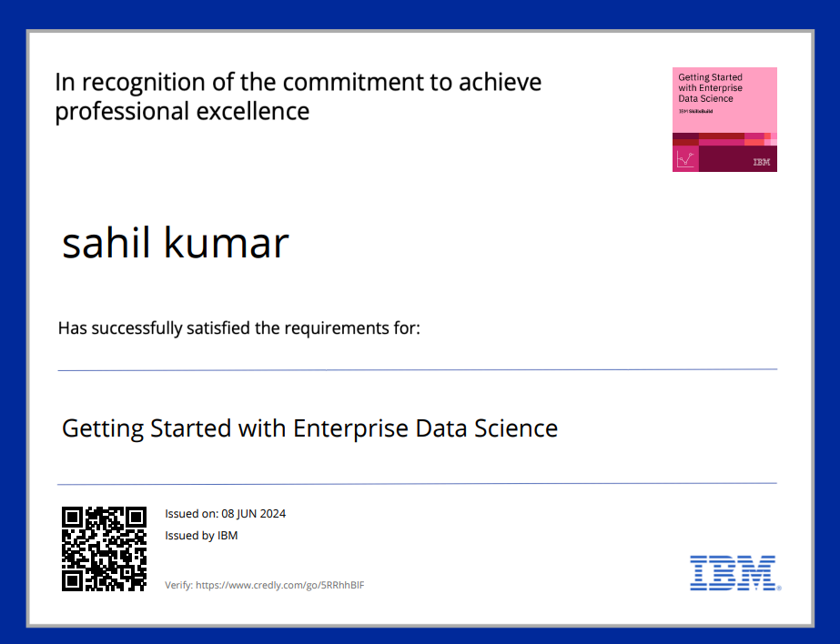

COURSE CERTIFICATE 2

Slide 22


COURSE CERTIFICATE 3

Slide 23


Thank you
Sahil Kumar​​
in linkedin.com/in/sahil-kumar-562529249

